Slide 1
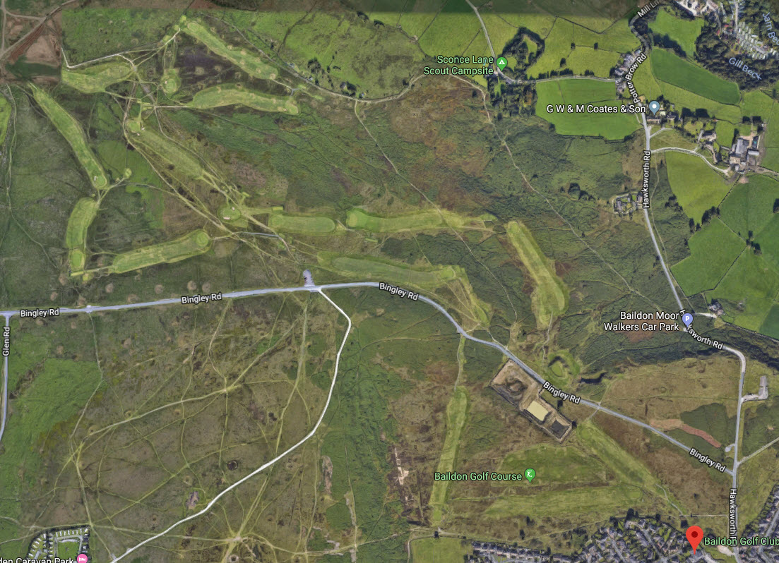

Cheltenham Gold Cup
Team Open
@baildongolfclub
XXth March 20XX

Slide 2
Team Tee Position Contact
TEAM A 1st First XXX
TEAM B 2nd First XXX
TEAM C 3rd First XXX
TEAM D 16th First XXX
TEAM E 5th First XXX
TEAM F 6th First XXX
TEAM G 7th First XXX
TEAM H 14th First XXX
TEAM I 15th First XXX
TEAM J 17th First XXX
TEAM K 1st Second XXX
TEAM L 3rd Second XXX
TEAM M 5th Second XXX
TEAM N 6th Second XXX
TEAM O 14th Second XXX
TEAM P 13th First XXX
TEAM Q 13th Second XXX
TEAM R 18th First XXX

Slide 3
Shotgun Start 9:00-9:07am
P
G
F
I
E
D
H
J
C
B
A
R

Slide 4
Shotgun Start 9:08 - 9:14am
G
Q
N
P
F
E
H
S
M
I
C
O
D
L
B
J
A
R
K

Slide 5
Shotgun Start 9:14 - 9:21am
G
F
E
Q
N
M
C
O
H
S
I
L
P
D
B
A
K
R
J

Slide 7
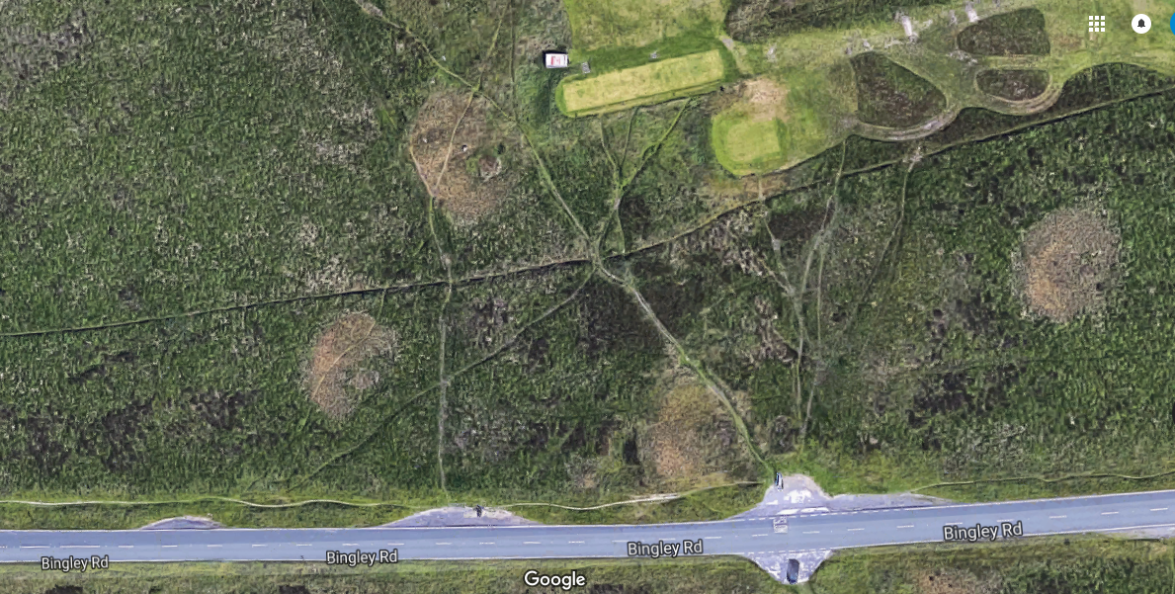
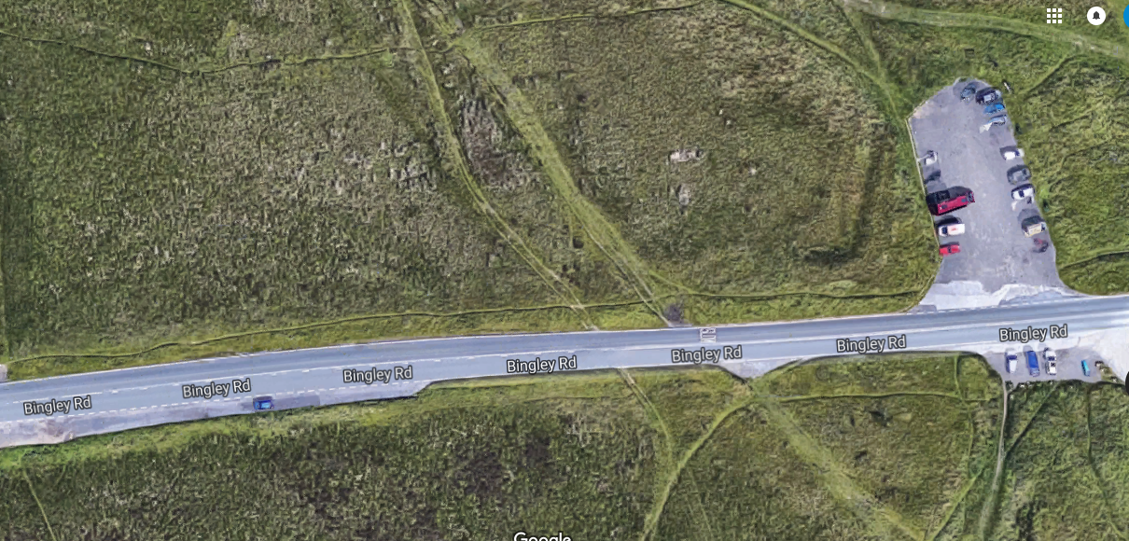
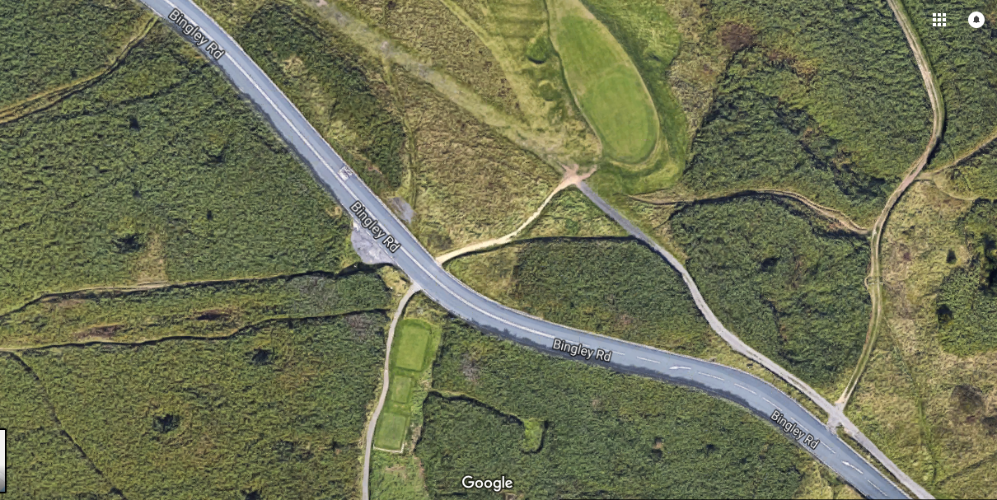
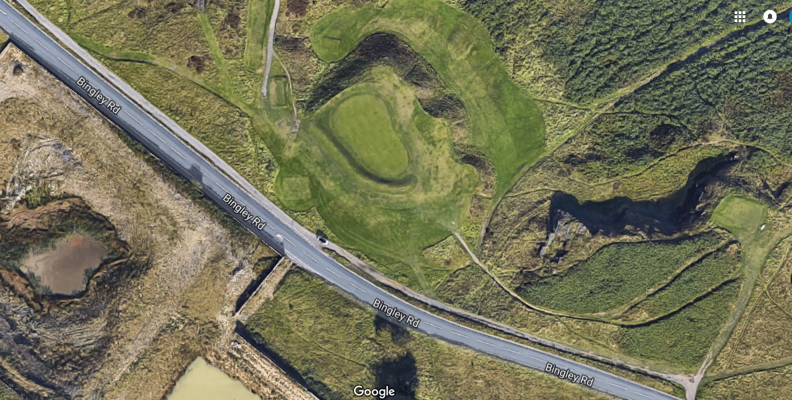

Slide 9



please SUPPORT THE CAPTAIN’S CHARITY 2019
www.thecalmzone.net

